Slide 1
Unit – III Business Model & Validation

Slide 2
Unit – III: Business Model & Validation: -
Types of Business Models
Lean approach
The Problem-Solution Test, Solution Interview Method
Difference between Start-up Venture and Small Business
Industry Analysis
Identify Minimum Viable Product (MVP)
Build-Measure-Lean Feedback loop
Product-market fit test.

Slide 3
TYPES OF BUSINESS MODELS
According to management guru Peter Drucker: “ A business model is supposed to answer who your customer is, what value you can create / add for the customer and how you can do that at reasonable costs”.
A Business Model is the way that a company sells products to its customers. It describes how a Business creates, delivers, and captures value
A Business Model is a conceptual structure that supports the viability of a product or company and explains how the company operates, makes money, and how it intends to achieve its goals. All the business processes and policies that a company adopts and follows are part of the business model.

Slide 4
Every Business Model Intrinsically Has Three Parts
Everything related to designing and manufacturing the product
Everything related to selling the product, from finding the right customers to distributing the product
Everything related to how the customer will pay and how the company will make money
There are four basic types of business model that any for-profit business will fall into:
Manufacturer
Distributor
Retailer
Franchise

Slide 5
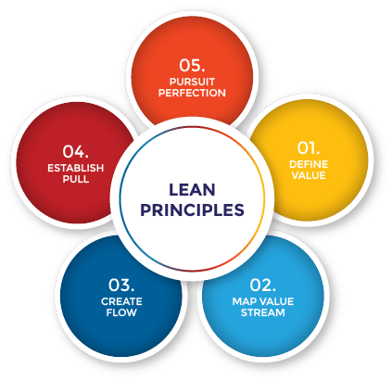
LEAN APPROACH AND IT’S KEY FIVE PRINCIPLES
The lean approach is a way to think about the start up process that emphasizes the business model over the business plan, and encourages a process of customer discovery and development, and iteration to achieve the right product / market fit.
Simply, lean means creating more value for customers with fewer resources.
A lean organization understands customer value and focuses its key processes to continuously increase it.
The ultimate goal is to provide perfect value to the customer through a perfect value creation process that has zero waste.

Slide 6
Value.: Value is always defined by the customer’s needs for a specific product.
What is the timeline for manufacturing and delivery?
What is the price point?
What are other important requirements or expectations that must be met? This information is vital for defining value.
2. Value stream: Once the value (end goal) has been determined, the next step is mapping the “value stream,” or all the steps and processes involved in taking a specific product from raw materials and delivering the final product to the customer.
Value-stream mapping is a simple but eye-opening experience that identifies all the actions that take a product or service through any process.

Slide 7
3.Flow.:After the waste has been removed from the value stream, the next step is to be sure the remaining steps flow smoothly with no interruptions, delays, or bottlenecks. “Make the value-creating steps occur in tight sequence so that the product or service will flow smoothly toward the customer,”
4. Pull.: With improved flow, time to market (or time to customer) can be dramatically improved. This makes it much easier to deliver products as needed, as in “just in time” manufacturing or delivery. This means the customer can “pull” the product from you as needed (often in weeks, instead of months).
5. Perfection.: Accomplishing Steps 1-4 is a great start, but the fifth step is perhaps the most important: making lean thinking and process improvement part of your corporate culture. it is important to remember lean is not a static system and requires constant effort and vigilance to perfect

Slide 8
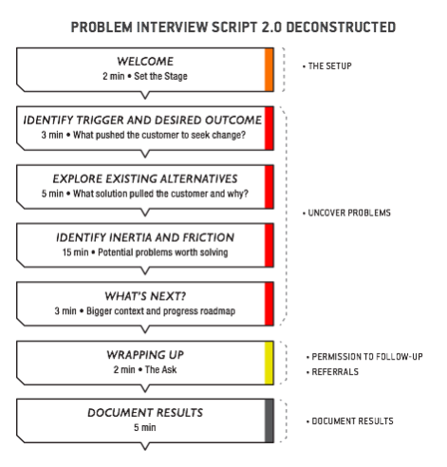
THE PROBLEM-SOLUTION TEST
Before you can build the “right” solution for your customers, you have to understand the “right” problem.
Inspired by the Scientific Method, the search for Problem / Solution fit starts with creating a model — specifically a business model, you take your best guess at articulating a customer and problem.

Slide 9
Triggers create a desire for better.
Taken together, the trigger and desired outcome create anchor points for the customer journey story you want to learn about.
Example: When entrepreneurs get hit with an idea, they might define securing funding or building/launching their product as the desired outcome.
Existing Alternatives and Current Solution
What attributes attracted the customer?
What solutions did the customer consider?
Inertia, Friction, and Next Summit
For each solution (starting with their most recent), you want to get the customer’s story on how they found, selected, used the solution, and what’s the next goal for them :
Inertia represents obstacles and roadblocks that hold the customer back at the time of choosing a new solution.
Friction occurs further down the road. Friction represents obstacles and roadblocks that get in the way during usage. The last step is assessing how well the job was done with their chosen alternative.

Slide 10
The script starts out by setting the stage and setting a problem context, but the heart of the interview is around exploring your customer’s worldview because that’s where you gather empirical evidence that either supports or refutes your case.
The only reliable way to gather this evidence is by exploring what customers did in the past or will do in the present. Asking them what they’ll do in the future, e.g. “Will you use…”, puts you in the land of biases and should be avoided.
If you gather evidence that supports your problem assumptions (validation), you can pat yourself on the back and move to the next step of defining and testing a solution with a Solution Interview:

Slide 11
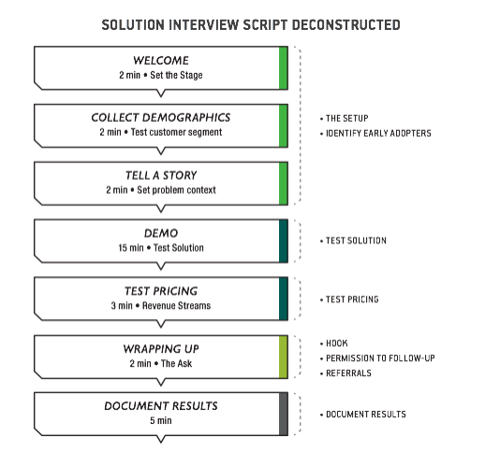
SOLUTION INTERVIEW METHOD

Slide 12
If, however, you don’t uncover evidence that supports your assumptions (invalidation), you have to dig deeper for new problems worth solving. This is where people stumble.
Here are a couple of reasons why:
Most of us unconsciously frame (or fake) problems around the solution we already want to build and then attempt to seek just enough evidence to convince ourselves we are on the right track.
Next, if you start with a non-problem, even though you can often see invalidation pretty quickly during the interview, recovering from it isn’t always easy.

Slide 13
CHARACTERISTICS OF START-UP AND SMALL BUSINESS
START-UP | SMALL BUSINESS
Start-Ups are fundamentally concerned with growth | Smaller Teams of Employees
Start-Ups must exhibit economies of scale | Small Market Area
Start-Ups must pursue large markets | Sole or Partnership Ownership and Taxes
Start-Ups operate under conditions of extreme uncertainty | Limited Area of Fewer Locations
Start-Ups market their products / services in very unique ways | Lower Revenue and Profitability

Slide 14
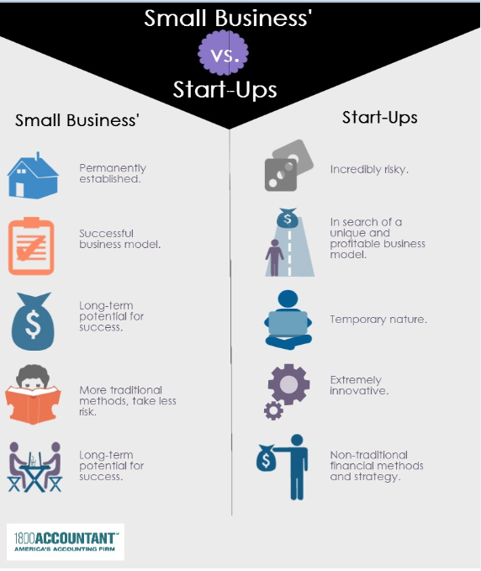

Slide 15
INDUSTRY ANALYSIS
An Industry is a system consisting of a group of manufacturers or businesses with the common objective of producing a particular kind of goods or services. There are different types of industries and industry sectors with a number of firms doing business with profit motivation.
Industry Sector Analysis | People Perception Analysis
Industry Trend Analysis | Industry Contribution To GDP
Environmental Analysis | Market Demand Analysis
Competitors Analysis | Opportunity Analysis
Alternative Product / Service Analysis | Government Policy Analysis
Financial Performance Analysis | Industry –Employment Generation
Industry ABCD Analysis | Latest Industrial Development Analysis
Industry SWOC Analysis | Top Leading Companies In Industry
Product / Service Analysis | Cross Industry Analysis
Investment Analysis | Market Size Analysis
Automation and Labor Analysis | Information Technology Implementatio
Studying Industry Innovations using Six Thinking Hats

Slide 16
INDUSTRY ANALYSIS Includes……
1.Industry Sector Analysis: An industry sector contains a segment of industries of a particular type in a given economy.
Examples are materials sector, financial sector, food sector, energy sector, transportation sectors, health sector, education sector etc.
2. Industry Trend Analysis: The present and future trend of a given industry are analyzed in this stage. Based on changes in the economy, technology, environment, and people aspirations, the opportunity and the growth trend of an industry are affected.
3.Environmental Analysis : This includes analysis of challenges and opportunities for the growth of industries based on environmental factors. This may also include internal industry environment and external factors affecting the industry.

Slide 17
4.The Competitor’s Analysis can be done as per the guidelines in Porter's 5 Forces Analysis. This include
Threat of new entrants to the given industry.
Threat of substituent products or services or technology in that industry.
Bargaining power of customers on pricing, quality, and after-sales support.
Bargaining power of suppliers while supplying various resources in a given industry and the ability of companies to sustain and negotiate. The strength of bargaining power of supplier depends on their switching cost.
The competition among the revelry in the given industry and its consequence on their profit and sustainability for Analysis
5.Alternative Product/service Analysis: Alternative products/service analysis may give rise to new innovative business models or processes in a given industry.

Slide 18
6.Financial Performance Analysis: The average financial performance of an industry in terms of overall investment in a given economy/country, in terms of initial investment, working capital and maintenance expenditure, the average return on investment, comparison of share prices, assessment of current position, prediction of current profitability & growth prospects, and future investment opportunities & returns have to be analyzed.
7.Industry ABCD Analysis: The affecting factors are identified under the constructs advantages, benefits, constraints, and disadvantages of
selected key issues.
8.Industry SWOC Analysis : SWOC is an acronym for Strengths, Weaknesses, Opportunities and Challenges, SWOC Analysis is the most renowned tool for audit and analysis of the overall strategic position of the industry and its environment. Its key purpose is to identify the strategies that will create an industry specific business model that will best align the available resources and capabilities to the requirements of the environment in which the firms in an industry operates.

Slide 19
9. Product/Service Analysis: The quality, suitability, durability, features, and acceptability of a product or service by its customers and further possible innovations are the main essences of product/service analysis.
10. Investment Analysis: factors that will be looked at include:
Revenues, expenses and income
Growth prospects for the company
The competitive factors the company faces
Expected return on equity or assets in the industry
11. Automation & Labor Requirement Analysis :Based on the analysis, one can determine a given industry as capital intensive or labor intensive.
12. People perception Analysis: The perception about the given industry, its products or services, usefulness of that industry to the society, environmental effect of that industry, contribution of that industry to the economical change and social change of the country.

Slide 20
13. Size of the Industry & Total Contribution to the Economy : Analyzing the size of the given industry, the number of companies functioning, the contribution to economy and GDP by the industry.
14. Market Demand Analysis: This analysis helps to determine if the companies in a given industry can successfully enter a market and generate enough profits to advance its business operations.
15. Opportunity Analysis: The various opportunities in a given industry for its products and services, growth and expansion, improved business models, better margins, brand building, economy of scale etc.
16. Government Policy Analysis :This section should focus on how the government policies on a given industry are supported or hindered its performance and growth.
17. Industry Contribution & Employment Generation Analysis :Industry contribution towards creating employment, supporting other industries, and contribution towards foreign export
18. Latest Industrial Developments: Studying, and analyzing short time and long time changes/developments in an industry based on changes in business models, changes in technology, changes in people aspirations, and changes in local/ country Govt. policies,

Slide 21
19. Top leading Companies in an Industry & their Strategies : The analysis can also include the study of various strategies used by such companies in a given industry.
20. Cross-industry Analysis : The cross-industry analysis focuses on comparing the business features on various inter-related industries in horizontal (within an industry sector) and vertical (in different industry sector) integrated schemes.
21. Market Size: The data related to the market size of an industry can be collected to free resources on the web, Government sources, Trade associations, Financial Services Firms, and Online Data Providers
22. Information Technology Implementation :Depending upon the nature of products/services and their tangibility/intangibility, opportunity to use information technology supported e-business models in a given industry to decrease the cost of doing business and for global marketing
23. Studying Industry Innovations using Six Thinking Hats : Six thinking hats is a lateral thinking technique for solving any given problem in an industry innovatively

Slide 22
IDENTIFY MINIMUM VIABLE PRODUCT
A Minimum Viable Product (MVP) is a product with just enough features to satisfy early customers, and to provide feedback for future product development.
The Minimum Viable Product (MVP) gives you the chance to test the product in the real market conditions and with the everyday consumers to evaluate its performance.
Example: In 2009, Manuel Rosso, Food on the Table’s founder, had no mobile application or website for his service. But Manuel did amazing work to make sure that his startup idea was valuable for customers. First, Manuel found people willing to participate in his experiment. Then, he interviewed these participants and learned their food preferences and their budgets
Famous product that was initially launched with a MVP is Food on the Table. Food on the Table is a mobile application that collects your food preferences and then suggests recipes and grocery stores with the best deals to help you cook tasty and cheap dishes.

Slide 23
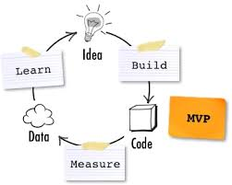
Steps To Building An MVP
Step 1. Define a problem you want to solve
Step 2. Define the target audience and narrow it down
Step 3. Evaluate your competitors
Step 4. Do the SWOT analysis
Step 5. Define the user flow
Step 6. Create a list of features and arrange them according to their priority
Step 7. Define the scope of MVP
Step 8. Choose the best-fit management
method and engineer an MVP
Step 9. Apply Alpha and Beta testing
Final Advice

Slide 24
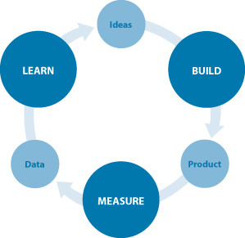
Build-Measure-Lean Feedback loop
A core component of Lean Startup methodology is the build-measure-learn feedback loop.
The first step is figuring out the problem that needs to be solved and then developing a minimum viable product (MVP) to begin the process of learning as quickly as possible
In practice, the model involves a cycle of creating and testing hypotheses by building something small for potential customers to try, measuring their reactions, and learning from the results Follow these steps to use the build BUILD-MEASURE-LEARN FEEDBACK LOOP:

Slide 25
PRODUCT - MARKET FIT TEST
Marc Andreessen defined the term as follows: “Product/market fit means being in a good market with a product that can satisfy that market.”
Many people interpret product/market fit as creating a so called minimum viable product that addresses and solves a problem or need that exists.
Olsen has created a process to help articulate, test and revise your business plan so you can achieve this goal. He proposes a six-step framework called the Lean Product Process.
Determine your target customer
Identify underserved customer needs
Define your value proposition
Specify your minimum viable product feature set
Create your minimum viable product prototype
Test your minimum viable product with customers

Slide 26
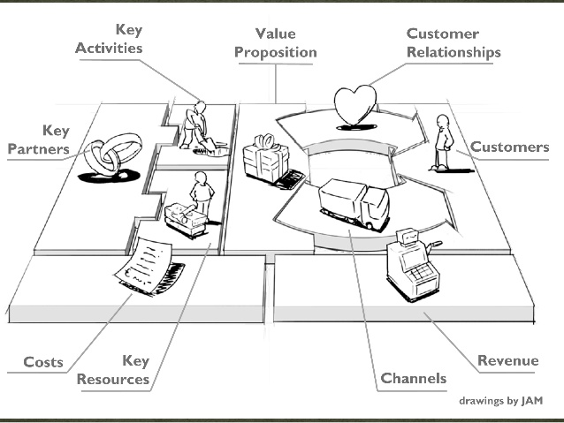
Product Market Fit = 2 parts
The Product : The part you control.
The Market : The part you don’t control.

Slide 27
Few Examples Of Product Market Fit.
If your product is “diapers “, your product market is B2C - newborn to up to 8 years
If your product is “milk”, your product market is the universe
If your product is “Audi”, your product market is for upper middle to upper class with higher income
If your product is “Allegra “, your product market- “people with allergies
A good example of “product-market fit” is a school application that helps students learn and warns teachers when a student isn’t achieving expected goals.
The market for airline travel; smart-phones, new cars; pharmaceutical products and the markets for financial services such as banking, mortgages and pensions.

